Slide 1
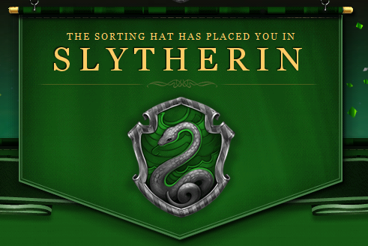
SLYTHERIN PYTHON TEAM
Notes:
Slythrin python ( team name) Slythrin photo

Slide 2
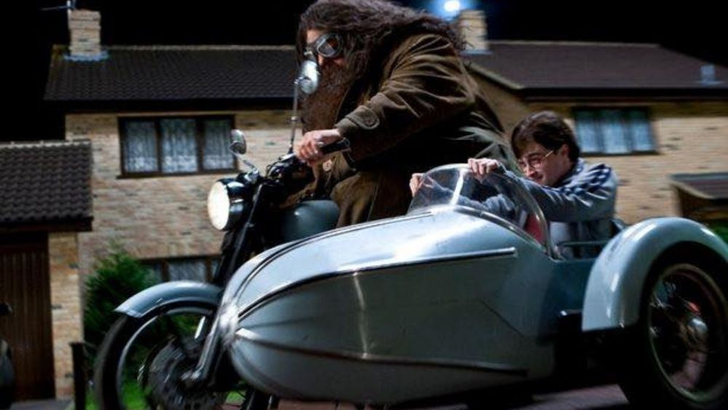
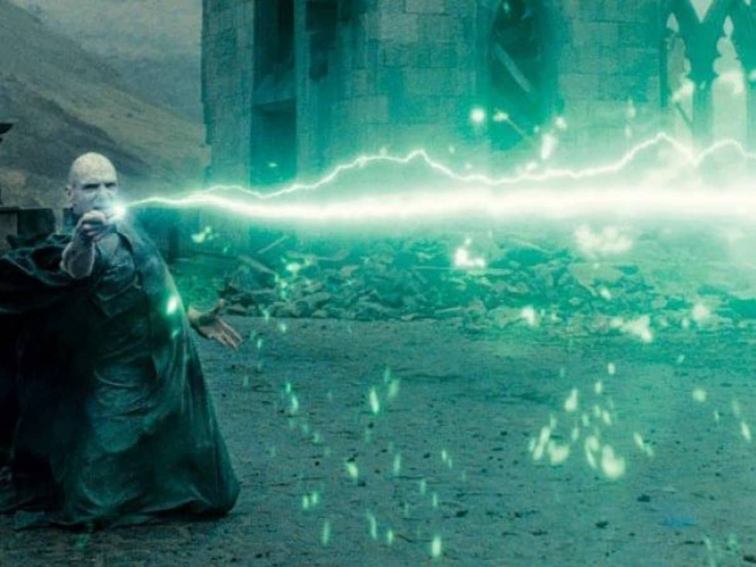

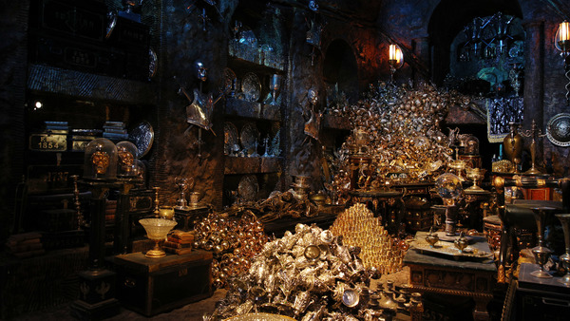
What is this Team about?
It’s about drive
we stay hungry
it’s about power
we devour

Slide 3
What will be discussed today
Tour to DEVSNEST website and Discord server
Quick introduction of every team member
Your expectations and suggestions
Permanent scrum timing
Role and responsibilities
Feedback

Slide 4


Notes:
Tour to DEVSNEST website and Discord server

Slide 5
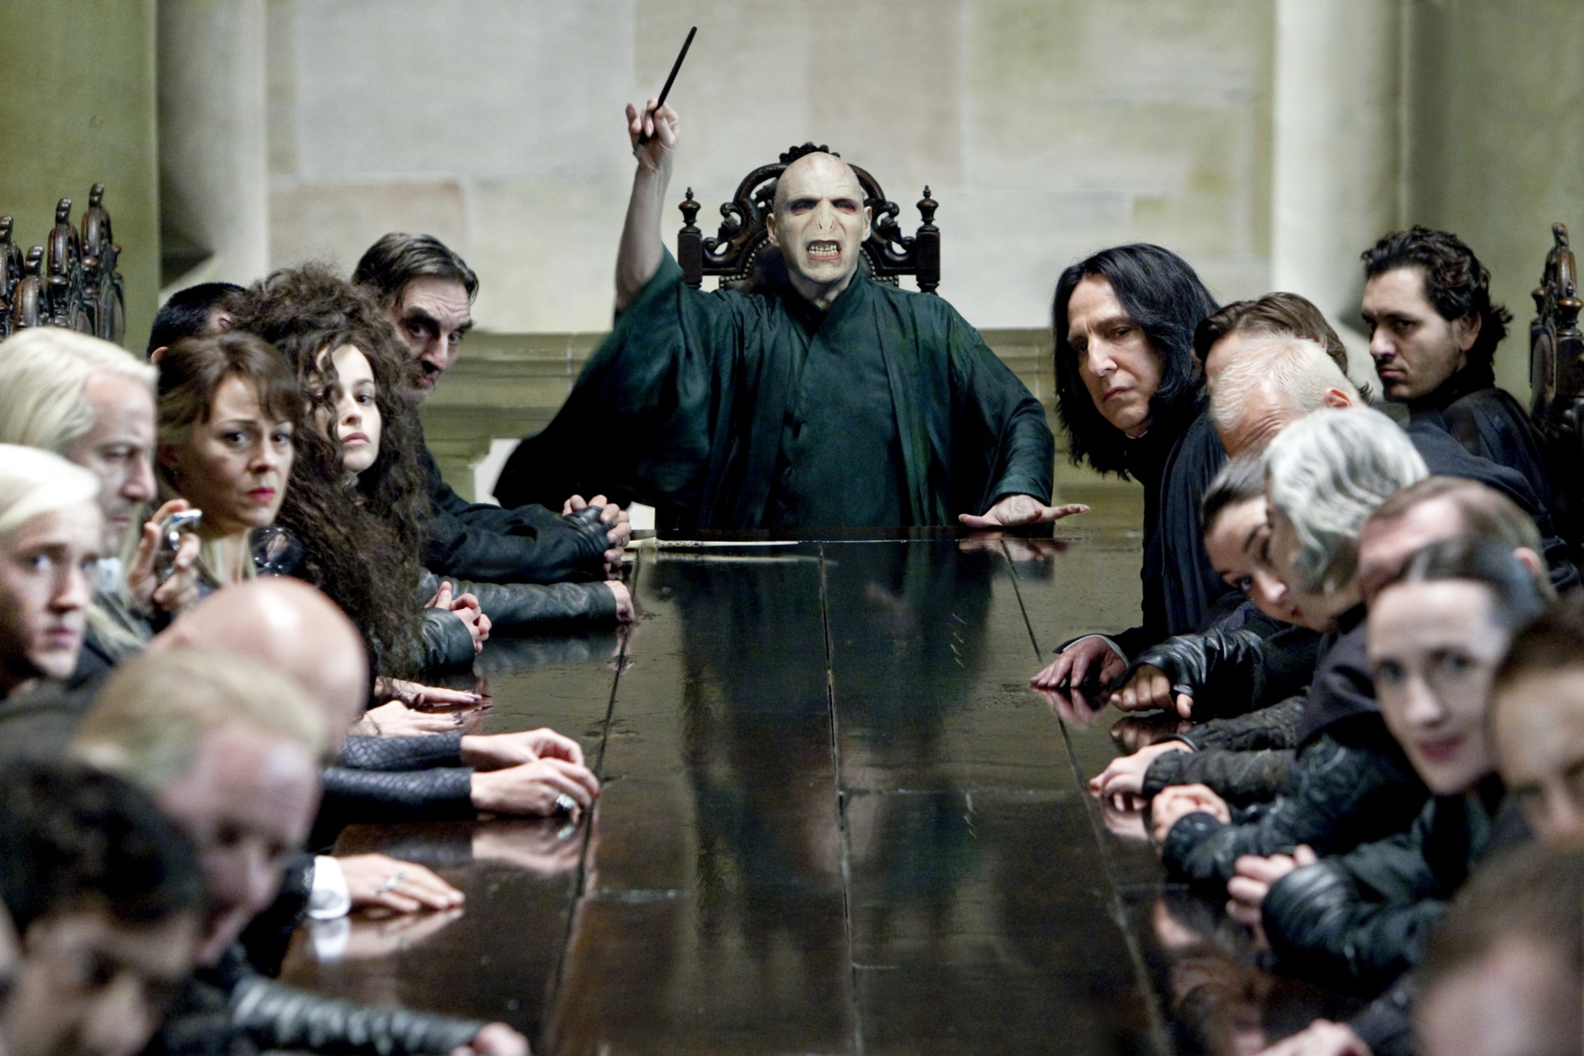
Notes:
Quick introduction of every team member

Slide 6
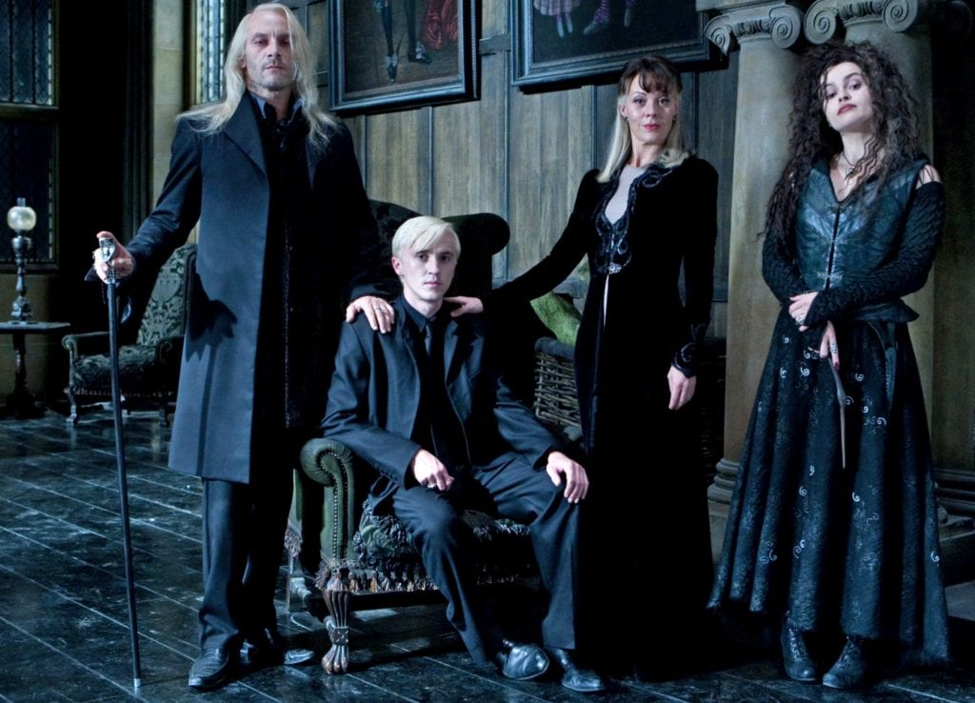
Notes:
Your expectations and suggestions

Slide 7
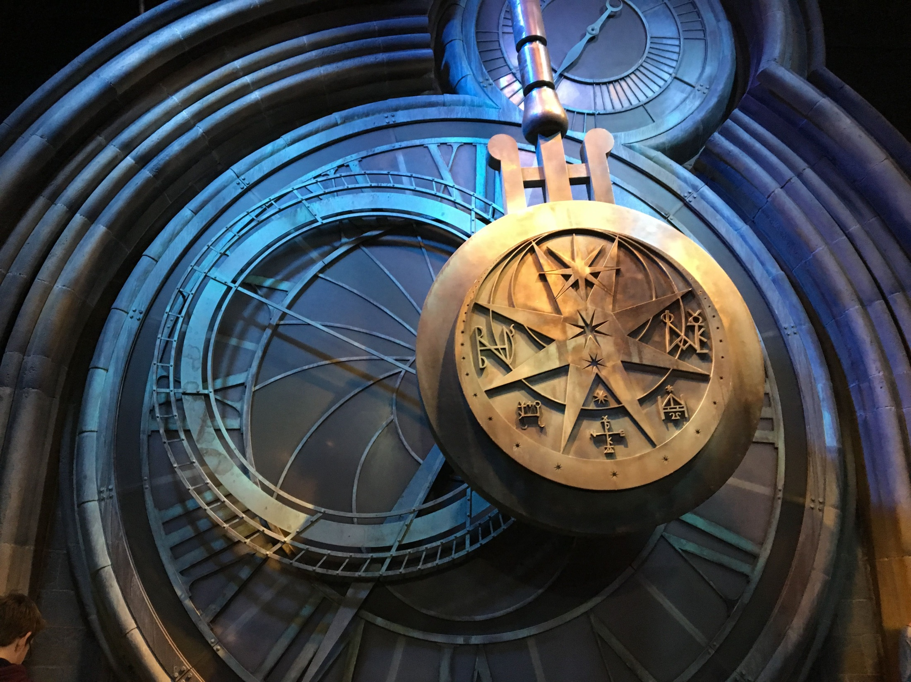
Notes:
Permanent scrum timing

Slide 8
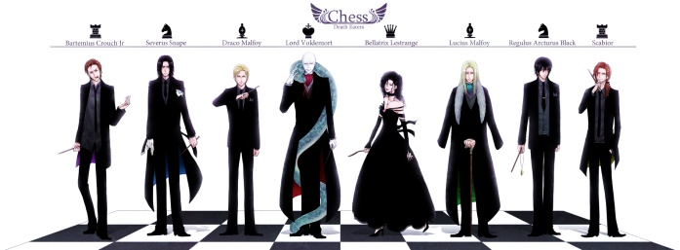
Notes:
Role and responsibilities

Slide 9
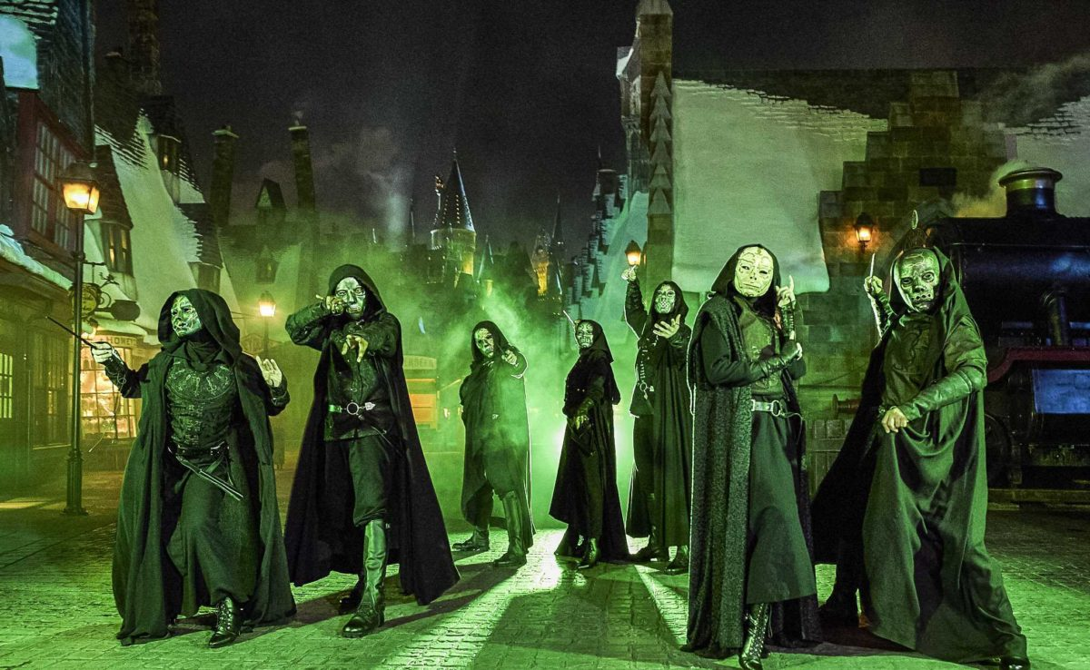
Notes:
Feedback

